Slide 1
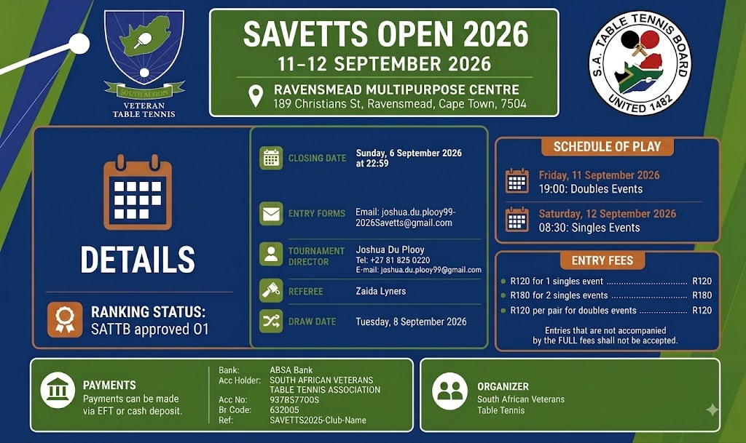












SAVETTS OPEN 2026
11-12 SEPTEMBER 2026
RAVENSMEAD MULTIPURPOSE CENTRE
189 Christians St, Ravensmead, Cape Town, 7504
DETAILS
SCHEDULE OF PLAY
CLOSING DATE
Sunday, 6 September 2026 @ 23:59
REFEREE
Friday, 11 September 2026
Zaida Lyners
19:00: Doubles Events
DRAW DATE
Tuesday, 8 September 2026
Saturday, 12 September 2026
08:30: Singles Events
TOURNAMENT
DIRECTOR
Joshua Du Plooy
+27 81 825 0220
joshua.du.plooy99@gmail.com
RANKING
SATTB approved O1
ENTRY FEES
●
R120 for 1 singles event ..................... R120
ENTRY FORMS
Email: joshua.du.plooy99+2026Savetts@gmail.com
●
R180 for 2 singles events ..................... R180
●
R120 per pair for doubles events ....... R120
Entries that are not accompanied
by the FULL fees shall not be accepted.
PAYMENTS
Bank:
ABSA Bank
ORGANIZER
Payments can be made
via EFT or cash deposit.
Acc Holder:
SOUTH AFRICAN VETERANS
TABLE TENNIS ASSOCIATION
Acc No:
9378577005
South African Veterans
Table Tennis
Br Code:
632005
Ref:
SAVETTS2026-Club-Name

